Slide 1
COMBINATIONAL CIRCUITS
COMPUTER SYSTEM ARCHITECTURE
BY:
ROSHNI PATOA

Slide 2
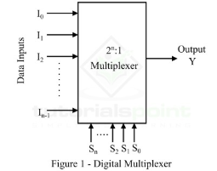
MULTIPLEXER
A multiplexer is a combinational circuit that has 2^n input lines and a single output line.
A multiplexer is an electronic switch that connects one out of ‘n’ inputs to an output.
It is functionally complete i.e. all Boolean functions can be realized using one multiplexer without any other gates.

Slide 3
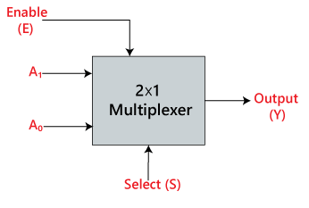
2X1 MULTIPLEXER
In 2×1 multiplexer, there are only two inputs, i.e., A0 and A1, 1 selection line, i.e., S0 and single outputs, i.e., Y. On the basis of the combination of inputs which are present at the selection line S0, one of these 2 inputs will be connected to the output. The block diagram and the truth table of the 2×1 multiplexer are given below.

Slide 4
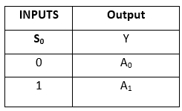
Truth Table for 2X1 MULTIPLEXER
The logical expression of the term Y is as follows:
Y=S₀'.A₀+S₀.A₁

Slide 5
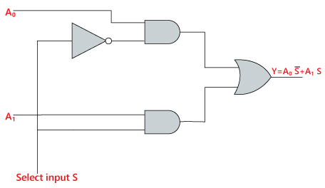
LOGIC DIAGRAM for 2X1 MULTIPLEXER

Slide 6
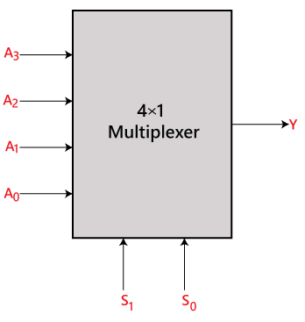
4X1 MULTIPLEXER
In the 4×1 multiplexer, there is a total of four inputs, i.e., A0, A1, A2, and A3, 2 selection lines, i.e., S0 and S1 and single output, i.e., Y. On the basis of the combination of inputs that are present at the selection lines S0 and S1, one of these 4 inputs are connected to the output. The block diagram and the truth table of the 4×1 multiplexer are given below.

Slide 7
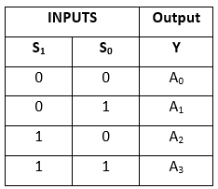
Truth Table for 4X1 MULTIPLEXER
The logical expression of the term Y is as follows:
Y=S1' S0' A0+S1' S0 A1+S1 S0' A2+S1 S0 A3

Slide 8
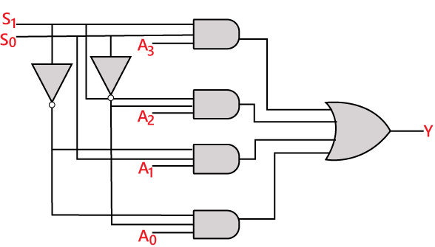
LOGIC DIAGRAM for 4X1 MULTIPLEXER

Slide 9
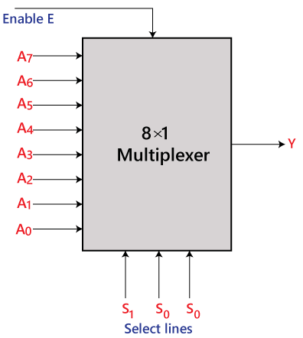
8X1 MULTIPLEXER
In the 8 to 1 multiplexer, there are total eight inputs, i.e., A0, A1, A2, A3, A4, A5, A6, and A7, 3 selection lines, i.e., S0, S1and S2 and single output, i.e., Y. On the basis of the combination of inputs that are present at the selection lines S0, S1, and S2, one of these 8 inputs are connected to the output. The block diagram and the truth table of the 8×1 multiplexer are given below.

Slide 10
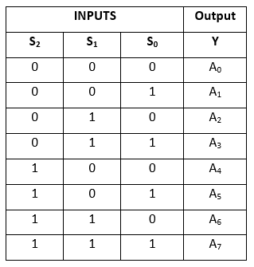
Truth Table for 8X1 MULTIPLEXER
The logical expression of the term Y is as follows:
Y=S0'.S1'.S2'.A0+S0.S1'.S2'.A1+S0'.S1.S2'.A2+S0.S1.S2'.A3+S0'.S1'.S2 A4+S0.S1'.S2 A5+S0'.S1.S2 .A6+S0.S1.S3.A7

Slide 11
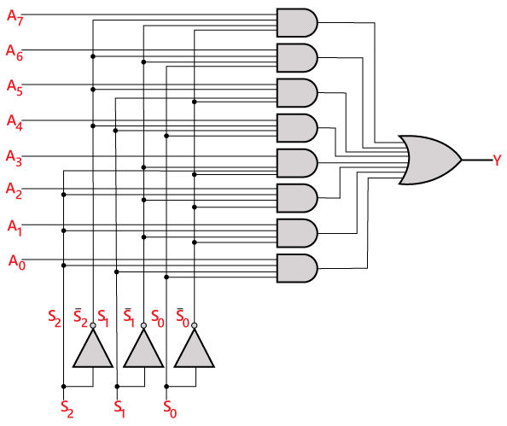
LOGIC DIAGRAM for 8X1 MULTIPLEXER

